Slide 1
Analyzing the best Neighborhoods to open an Indian Restaurant chain

Slide 2
Introduction INDIAN Restaurants
With all its exotic ingredients, unfamiliar dishes, and tongue-tingling flavors, Indian cuisine can be both exciting and intimidating. “It’s such a complete world of taste. You combine all the techniques from other cuisines and add magical spices to get a titillating food experience.
Indian Cuisine has been very famous in United states, Especially in Manhattan. People in US love to explore different Cuisine and they love the punch of Spices which Indian cuisine offers.

Slide 3
Problem
Launch Indian restaurant in Manhattan.
Don’t know where.
Wanted to launch in Neighborhoods where there are too many other restaurants and no Indian Restaurant.

Slide 4
Data Source
Luckily, the dataset which contains all the New York Borough and Neighborhood exists for free on the web. Link to the dataset: https://geo.nyu.edu/catalog/nyu_2451_34572
Foursquare.com for all the Venue Sourcing.

Slide 5
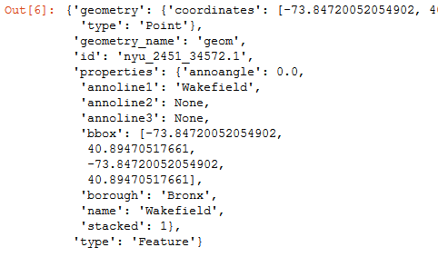
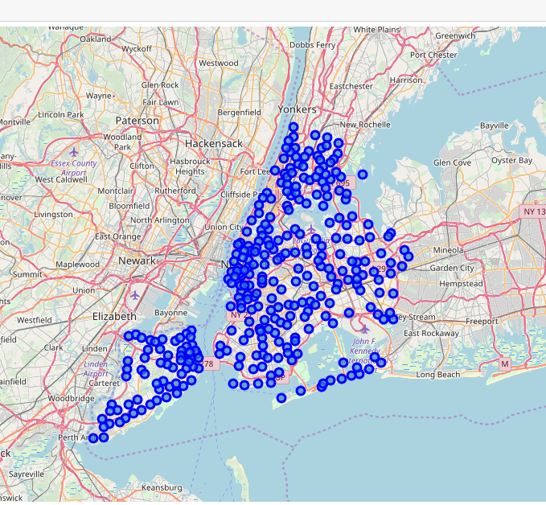
Data download and display

Slide 6
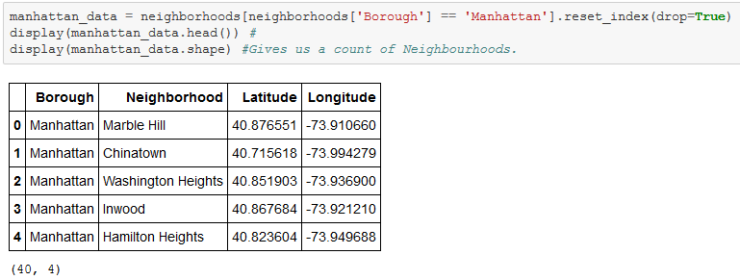
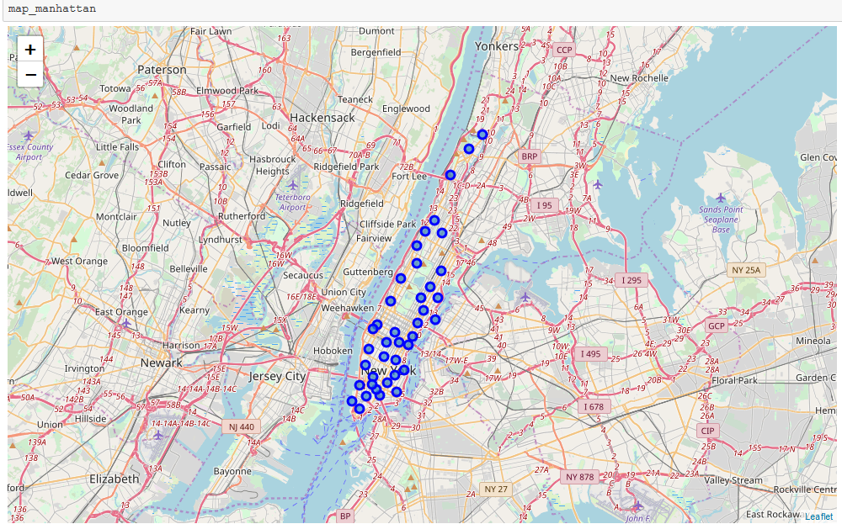
Displaying the Manhattan Neighborhoods

Slide 7
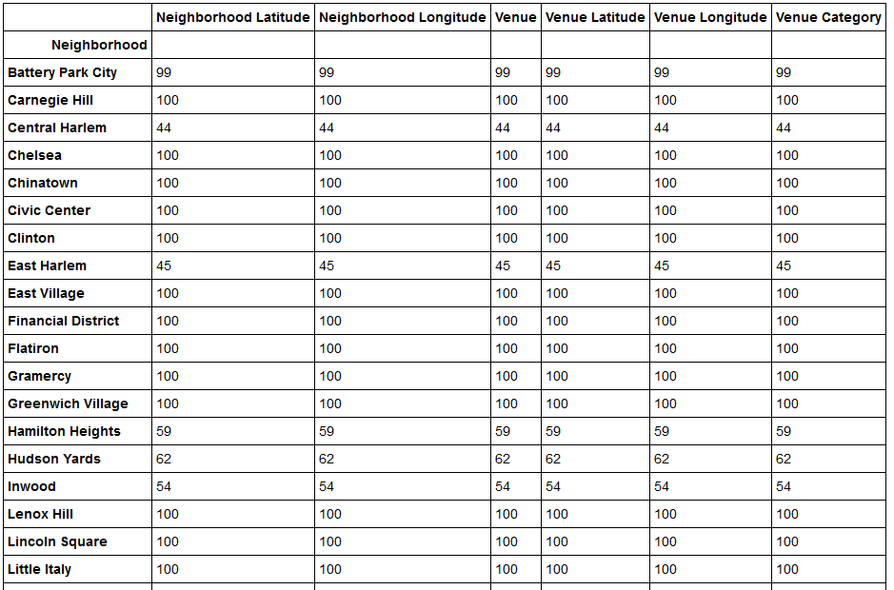
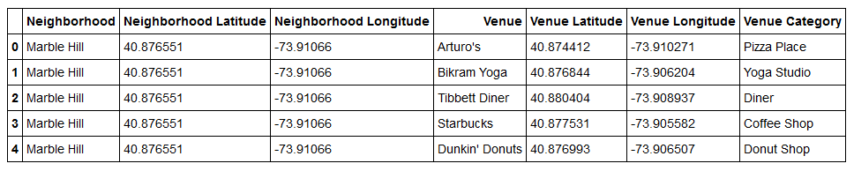
Forusuqare data gave me the Venues in those neighborhoods

Slide 8
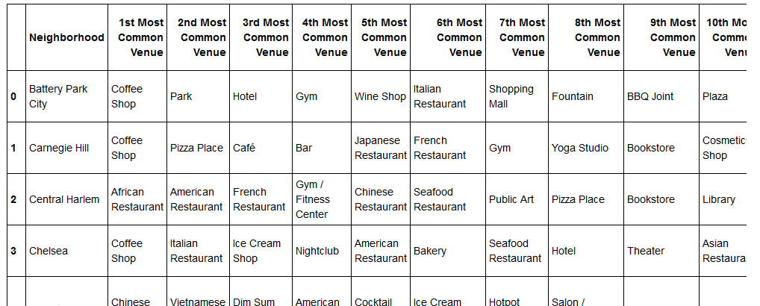
Displaying the top 10 Venues for few Neighborhoods

Slide 9
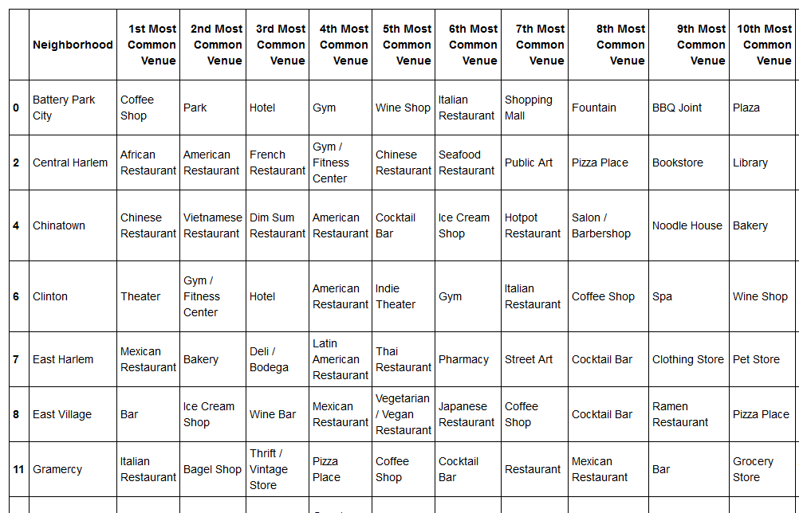
Deleting rows which included Indian restaurants

Slide 10
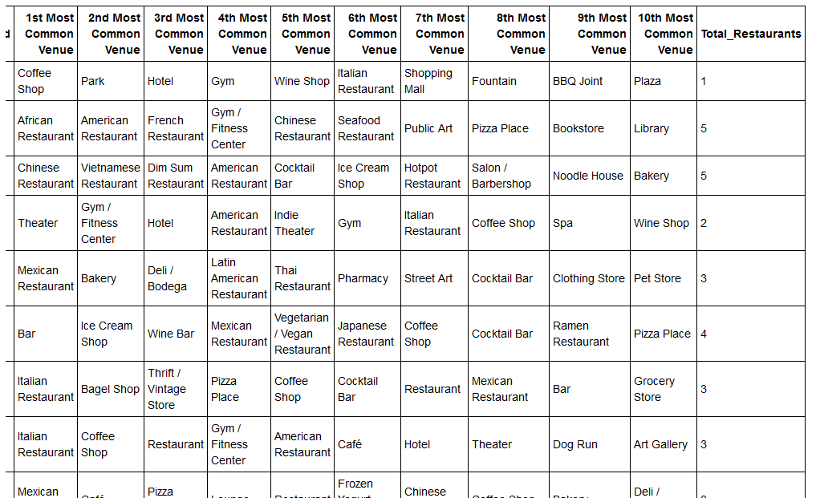
Counting the number of restaurants in the Neighborhoos

Slide 11
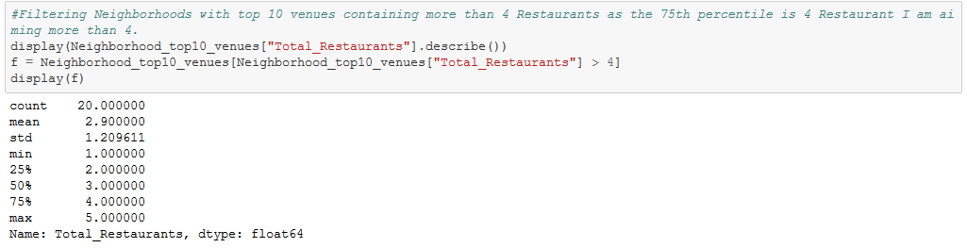
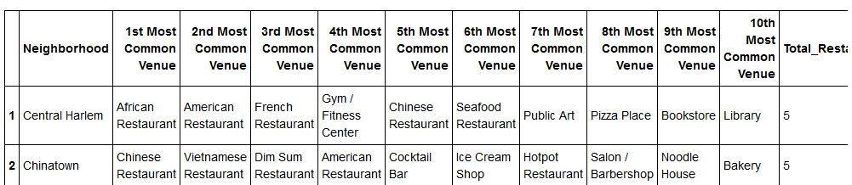
Displaying the top 2 which has more than 5 Restaurants in top 10 Venues

Slide 12
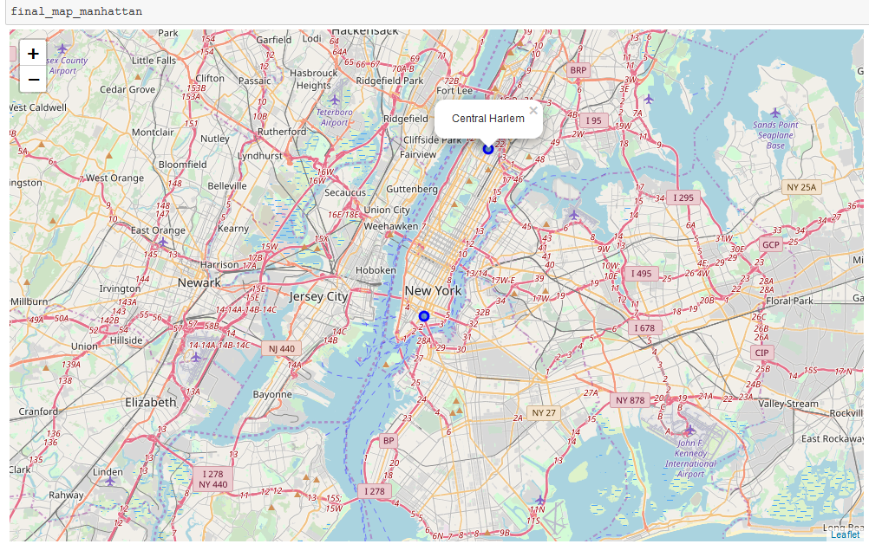
Displaying the Neighborhoods on map

Slide 13
Conclusion
The Restaurant owner can open his two new Indian Restaurants in “Chainatown Manhattan” and “Central Harlem Manhattan”.

Slide 14
Thank you

